Slide 1
JavaScript Tutorial
Prashanth Jaligama

Slide 2
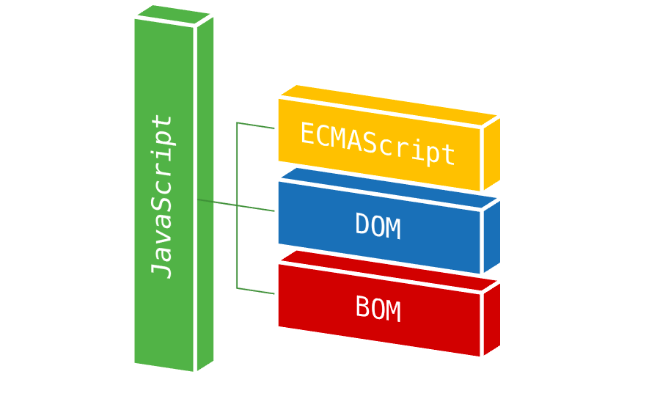
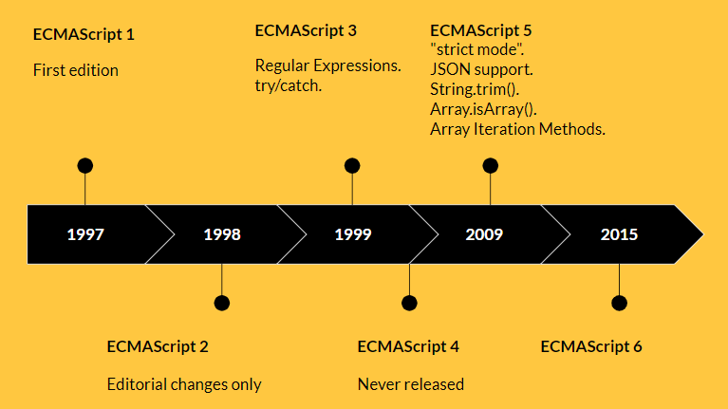
What is JavaScript?
History
First appeared in 1995 by Netscape Navigator
Simple data validation at client to full language
Core Implementation
Standardized by ECMAScript in 1997
DOM
BOM
Versions
ES1…ES5
ES6, ES7, ES8 and beyond

Slide 3
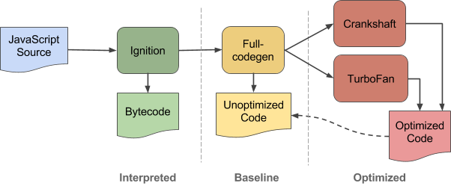
JavaScript Language
Interpreter language
V8 Engine - Runs on browser
JS in server side is in Node environment
Coding Hello World

Slide 4

JavaScript Hello world
Interpreter language
V8 Engine - Runs on browser
JS in server side is in Node environment
Coding Hello World in Browser Debug Console

Slide 5
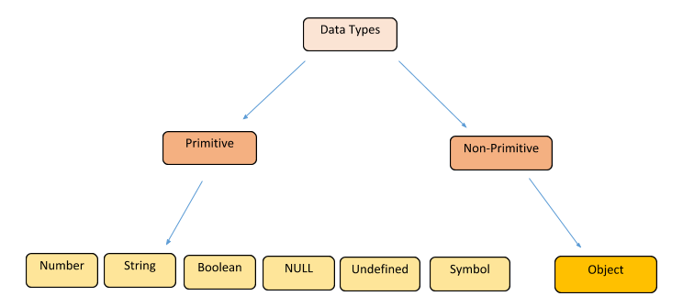
JavaScript Types
Data Types
Loosely typed
Can hold any type of data
var
undefined
null
Operators

Slide 6

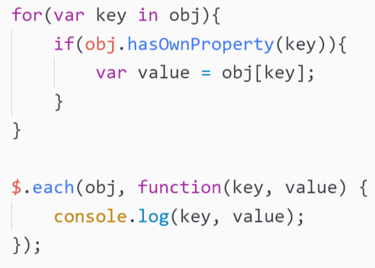
JavaScript Conditional and loops
If else
switch
for statement
for-in
for-each
for-of (ES6)
while loops
do-while
continue
break

Slide 7

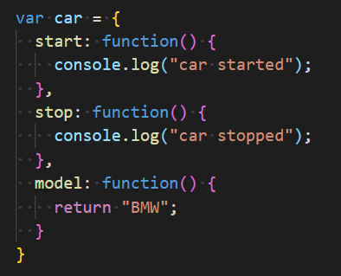

JavaScript functions
Case sensitive names
function keyword
Arguments
No Overloading, arguments are optional
Return statement (optional)
Types of declaring functions
function keyword
Inside a scope
ES6 functions

Slide 8
Coding Exercise
Ex-1. Write JS code for Hello World
Ex-2. Write JS code for adding two numbers
Ex-3. Write JS code for validating given numbers for digits
Ex-4. display addition, subtraction, division and multiplication of two given numbers
Ex-5. find reverse of a given sentence by reversing only words
“Hello World” ➔ “dlroW olleH”
“Sunday is Holiday” ➔ “adiloH si yaduuS”
Ex-6. Write a JavaScript to replace each character of a given string by the next one in the English alphabet. Note: 'a' will be replace by 'b' or 'z' would be replaced by 'a'. Types of declaring functions

Slide 9
Thank you
Reference
https://books.goalkicker.com/JavaScriptBook/

